Slide 1
Cause of Death Analysis
Ms. Sanaa Khan
Fliprobo- Intern

Slide 2
INTRODUCTION
Our World in Data's causes of death dataset is examined in this repository. All codes are in the the notebook, please check the .ipynb file in the commits. Link for accessing the data:
https://ourworldindata.org/causes-of-death
The dataset consists of 34 different cause of death counts by country per year. It covers the years from 1990 to 2017.

Slide 3
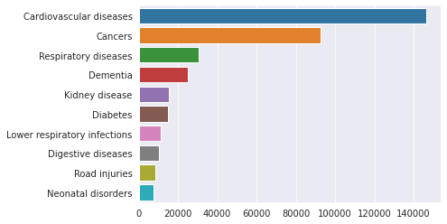
DATASET
Let's start exploring the dataset.
Top 10 causes of death for Turkey in the latest available year, 2017:

Slide 4
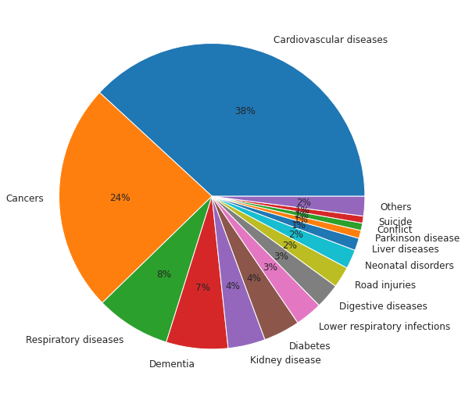
Percentages in pie graph: Almost 4 out 10 deaths in Turkey are caused by Cardiovascular diseases in 2017

Slide 5
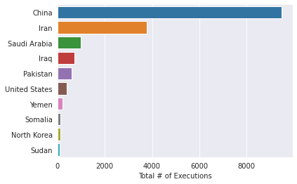
Top 10 countries with the highest execution numbers

Slide 6
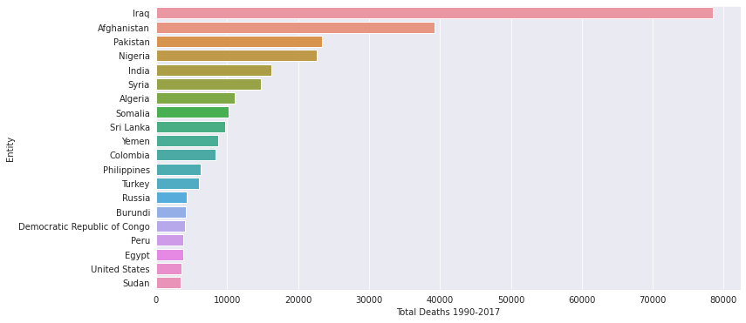
Top 20 countries which suffered from terrorism the most. Our dataset Entity column contains a mix of country, continent, region, territory information too such as Sub-Saharan Africa, South America etc.

Slide 7
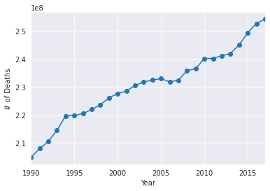
Deadliest year appears to be 2017, however this is due to the increase of the world population each year. We need to check death rate per year.

Slide 8
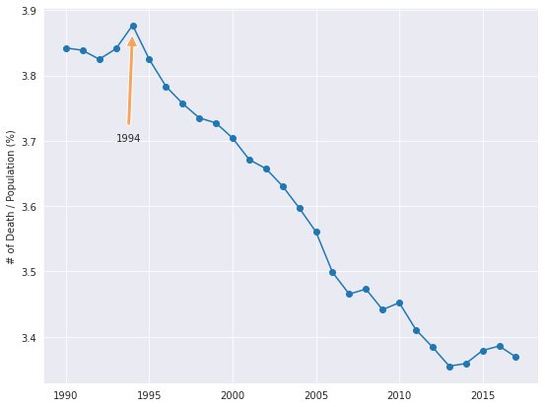
Find world population per year from the internet and plot year vs death rate (%): 1994 was the deadliest year with almost 4% of the population was died

Slide 9
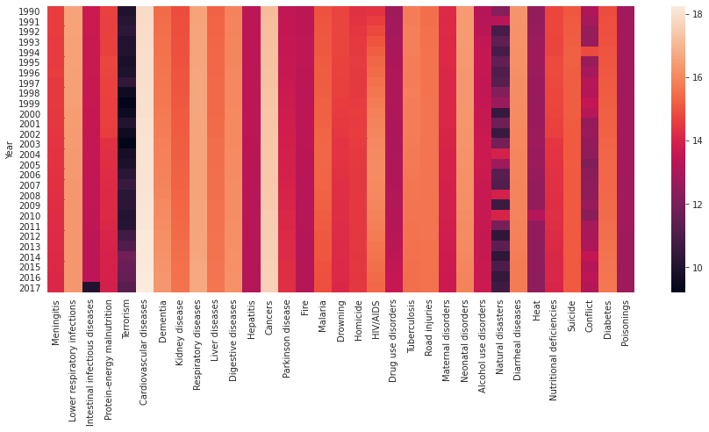
Lets examine what was the cause for this high death rate in 1994. Conflict line of the heatmap shows an interesting light colour on year 1994 (the lighter the colour the higher the number of deaths)

Slide 10
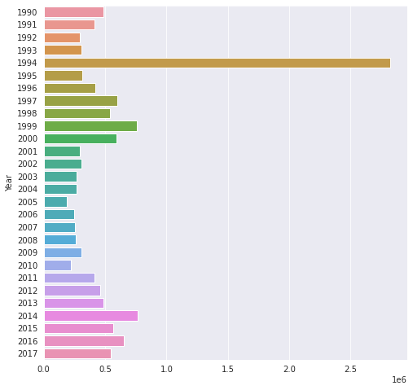
Conflict graph shows that 1994 was the year where the deadliest conflicts took place in the world. Bosnian War in Europe may have contributed to it significantly.

Slide 11
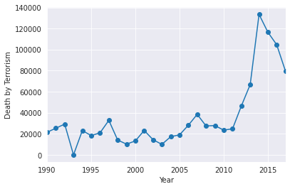
Death by terrorism peaked in 2014, and has been declining since then, however no effect was observed on 1994 death toll

Slide 12
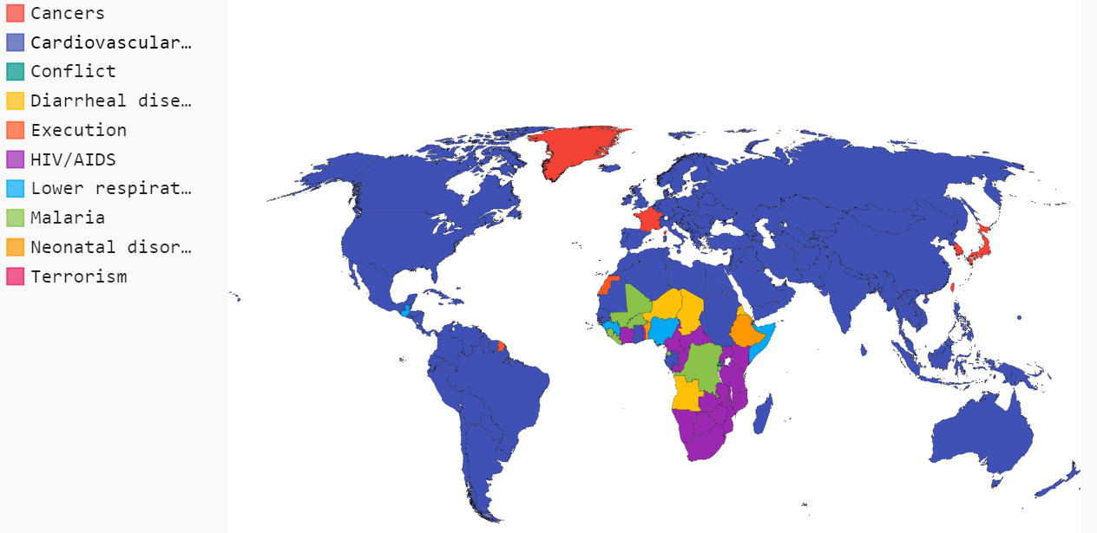
Let's find out which country suffers from what disease the most

Slide 13
SUMMARY
Let's now group the diseases by their historical increasing or decreasing trends. Calculations will be based on deaths per 100000 for particular disease.
Following diseases show monotonic decrease trend over years:
Even though Digestive and Respiratory diseases were dropping constantly for period of time, they started to enter an increasing trend since 2013. Still way better as compared to 90s
Suicide rates are dropping since mid-90s
Peak in the Heat graph could be a mistake in the dataset or it is a very distinguishing event happened in 2010 which caused this sudden jump

Slide 14
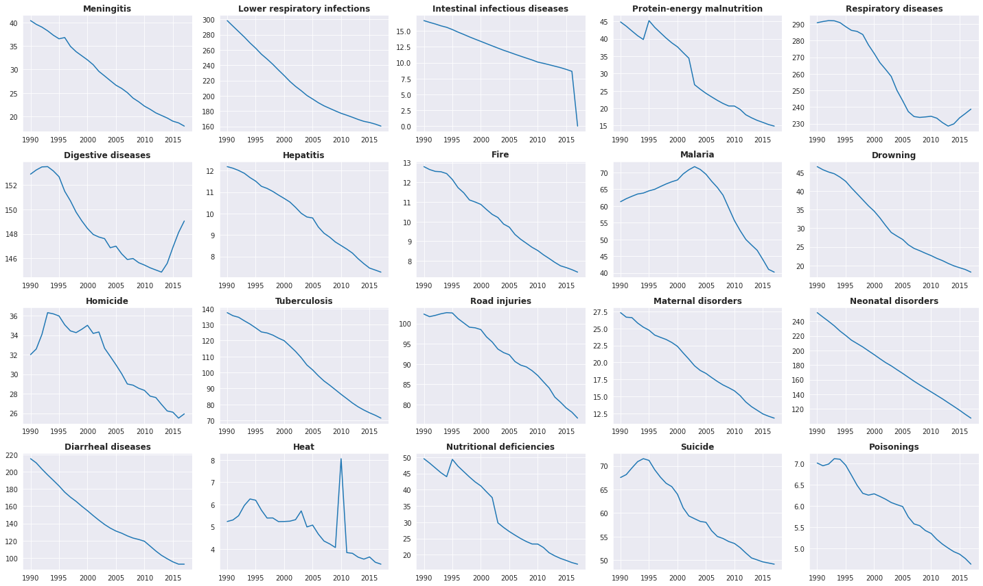

Slide 15
CONCLUSION
It is obvious that Cardiovascular Disease dominate death toll all over the world, how would the World map look if we took them out?
It appears that the second most leading cause of death in rich countries like USA, Canada, Europe, Japan and Australia is Dementia (mainly caused by Alzheimer's disease). This could be due to the high frequency of elder people in their population.
Conflict is leading cause for war territories like Syria and Palestine
For Russia and their neighbours like old Soviet Union countries, Eastern European countries leading cause is Digestive diseases like Ulcer, Cirrhosis, Hepatitis. It could be related to excessive consumption of alcohol.
Diarrheal diseases causes deaths mostly in the mid African region
HIV/AIDS deaths are the most frequent in the South African region
Some of the South American countries have Homicide as the leading cause for death
Lower respiratory infections like Tuberculosis, Pneumonia is the leading cause for mainly South American countries like Brazil and Argentina.
China, India and surrounding countries suffers from Respiratory diseases like Asthma and Lung Cancer etc.
The countries where road accidents are one of the leading cause of death are in the Gulf region like Iran, Saudi Arabia, UAE. It could be related to their habit of car stunt driving.
Greenland is the only country where suicide is the leading cause of death.

Slide 16
THANK YOU

